Slide 1

Challenge
Alpitour World
Presented by:
Block Shackle

Slide 2






Challenges
Bank service
Customer
Limited or lack of banking services
No means of validating customer participation in the tour
Currency
Payment
Need for currency exchange due to diverse currencies in use
Payment to the local guide based on the actual number of customers.

Slide 3




Solution
Implementing automatic payment to the guide based on the actual presence of customers during the tour
Utilizing digital payments with a preferred cryptocurrency
Validating customer presence through checkpoint scanning, accounting for GPS limitations
Notes:
opted for a different solution based on the limitations and complexity which GPS tracking introduces.
Privacy issue
GPS accuracy - bad weather, high buildings, indoors
Bad user experience
Another source of revenue could be achieved by partnering with other businesses and strategically placing the QR codes

Slide 4

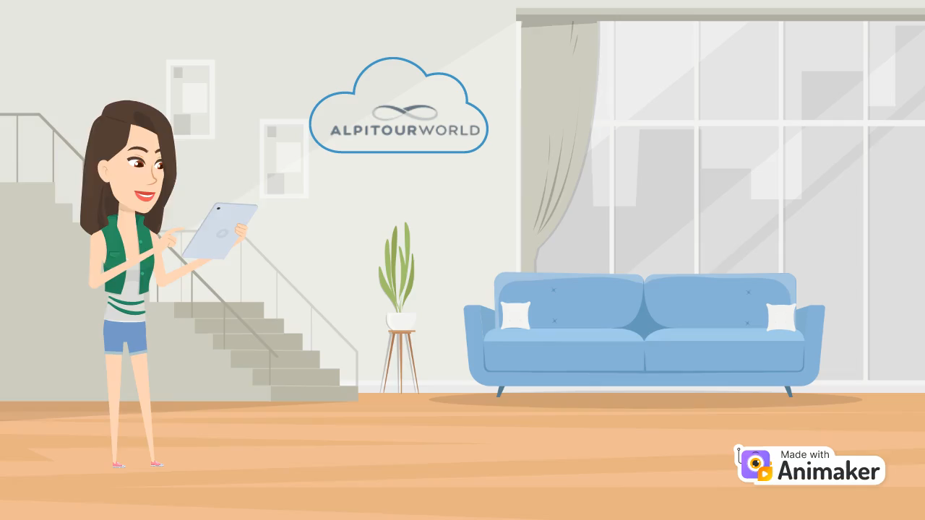
User story

Slide 5
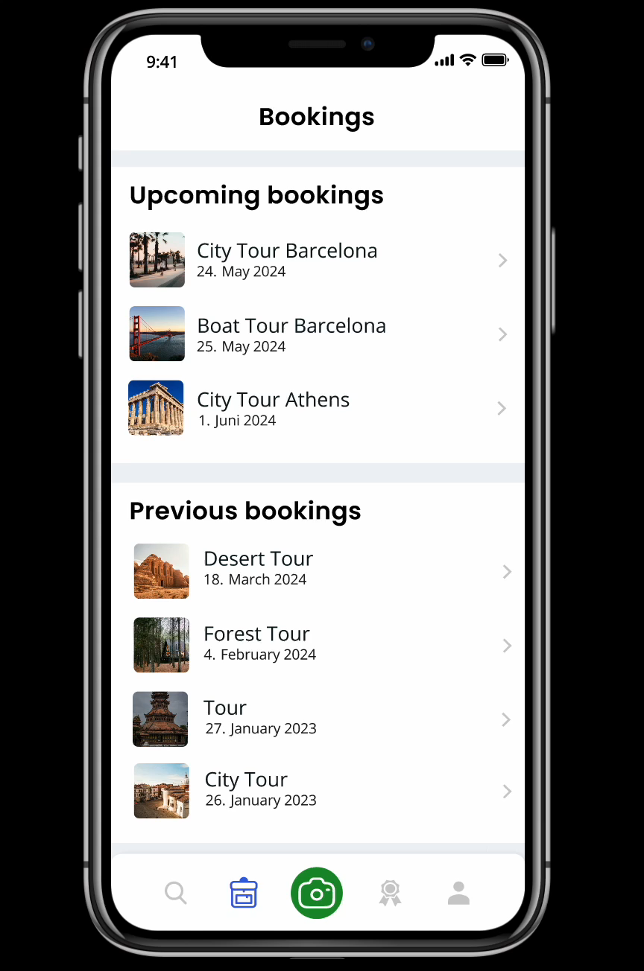
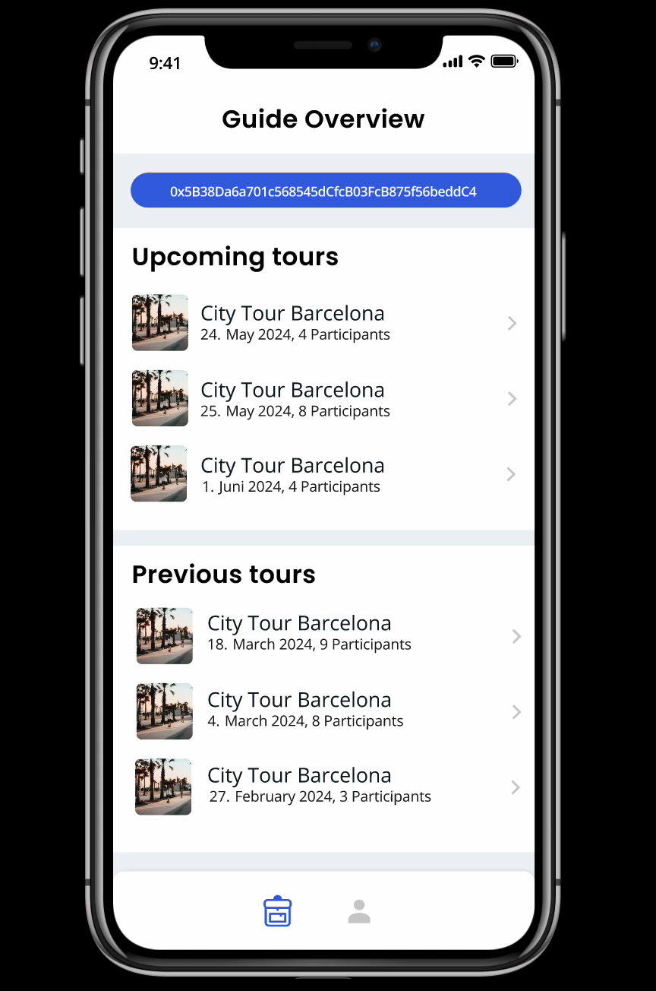
Customer (B2C)
Guide (B2B)

Slide 6


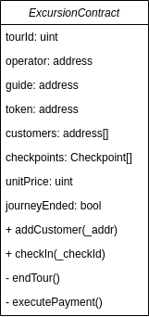
System Architecture
Alpitour
Backend
Guide
Customer
View the assigned tours
Validate customers
API - tours, profiles, bookings
Deploy and fund smart contracts
View their tour
Perform the check-in
Make transactions
Blockchain
Excursion Contract
NFT Contracts

Slide 7
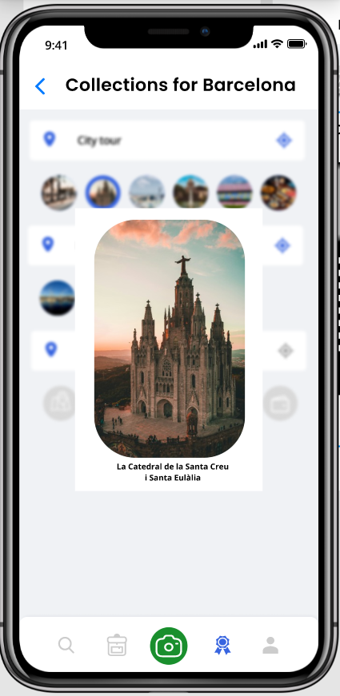
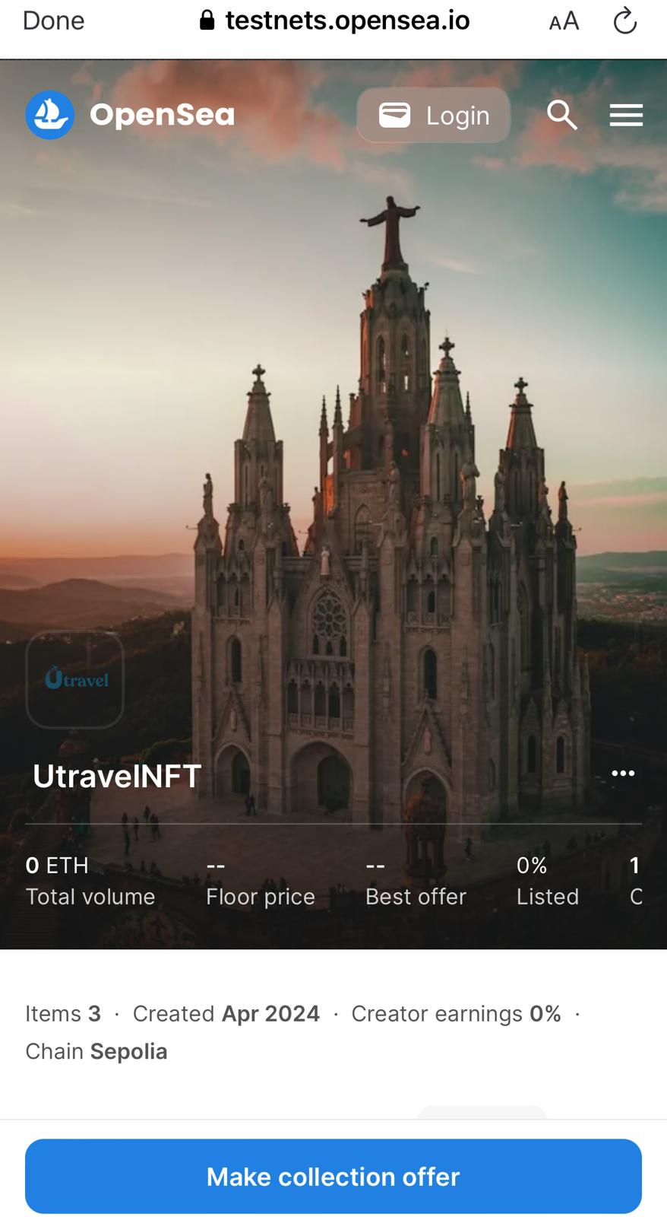

NFT Overview

Slide 8

Future Ideas
Direct transfer between the customer and guides
Improve edge case:
The customer does not check out
Implementation
Search for bookings
Personalized Recommendations
Reviews
Favorites
Notes:
Improve edge case - the customer does not check out - (un)intentionallyclose the contract after period of time (if no complaint was raised) (pay the amount for the users that have checked out)
Transferring funds directly between the customer and the local guide(no need for funding the contract, just receiving the fees)
Auto-close contract after set time if customers don't check out

Slide 9
THANK
YOU

